Slide 1




Slide 2




Technology Stack: MediStock Framework Explained
Spring Boot: The Backend Framework
PostgreSQL: The Database
React.js: The User Interface Library
Security: Authentication & Access Control
Spring Boot p;rovides the backend services and REST APIs for inventory management,epiry tracking,stock alerts and reporting.
PostgreSQL stock, expiry, batch and inventory-related data in a structured and reliable database.
React.js is used to built the interactive frontend of MediStock, including the dashboard, inventory views, alerts and report interfaces.
Spring Security with JWT/OAuth2 helps secure the application, authenticate users and protect backend APIs.

Slide 3
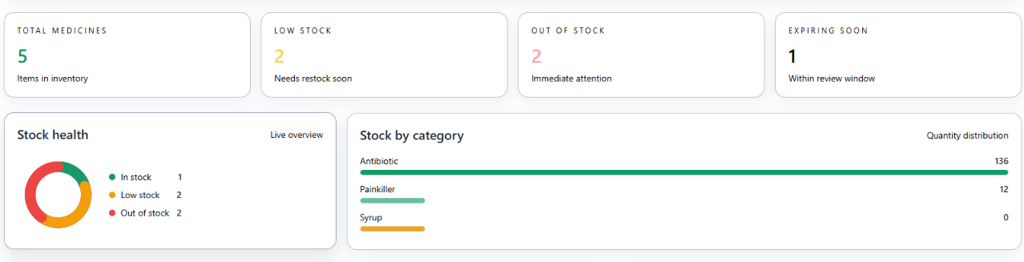
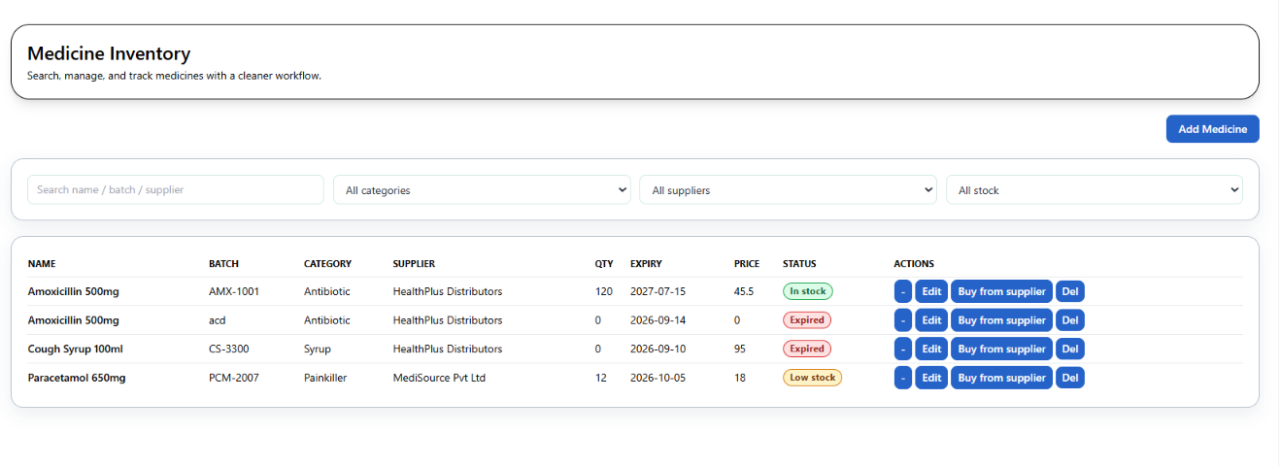
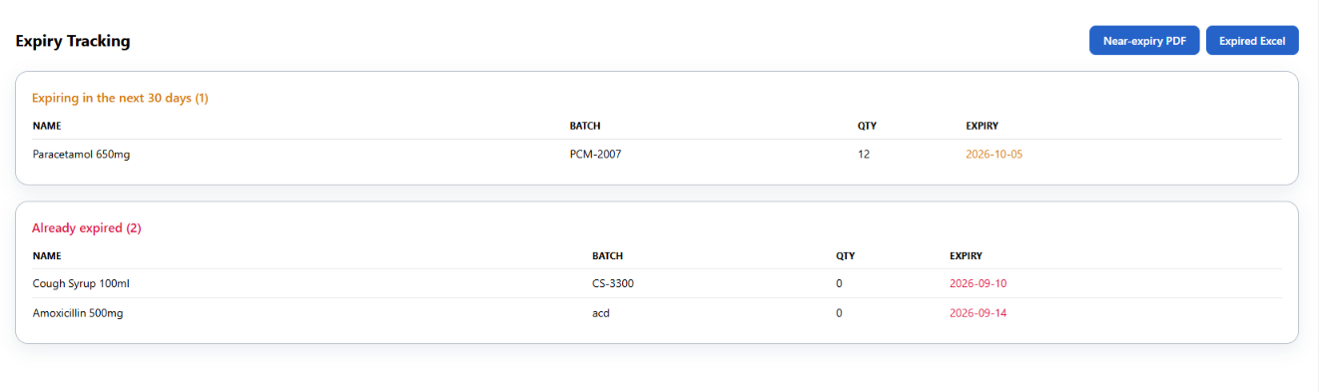
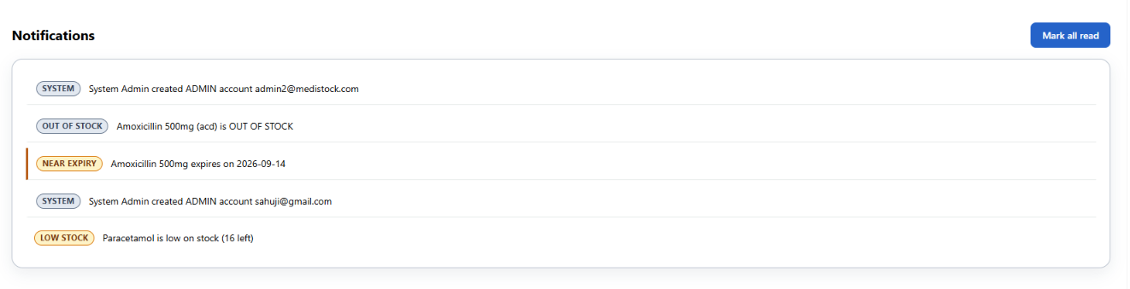
Core Features of MediStock Platform
Stock Alerts Made Easy
Inventory Analytics Made Easy
Expiry Monitoring Made Easy
Notifications

Slide 4
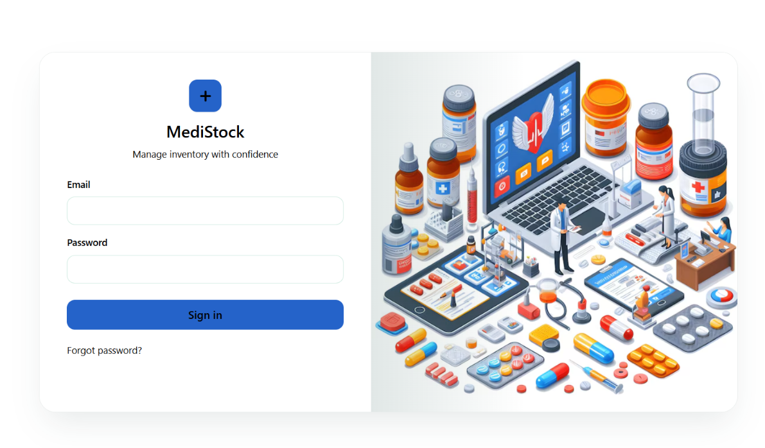
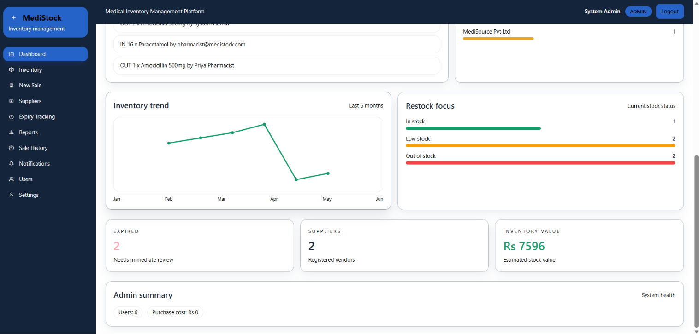
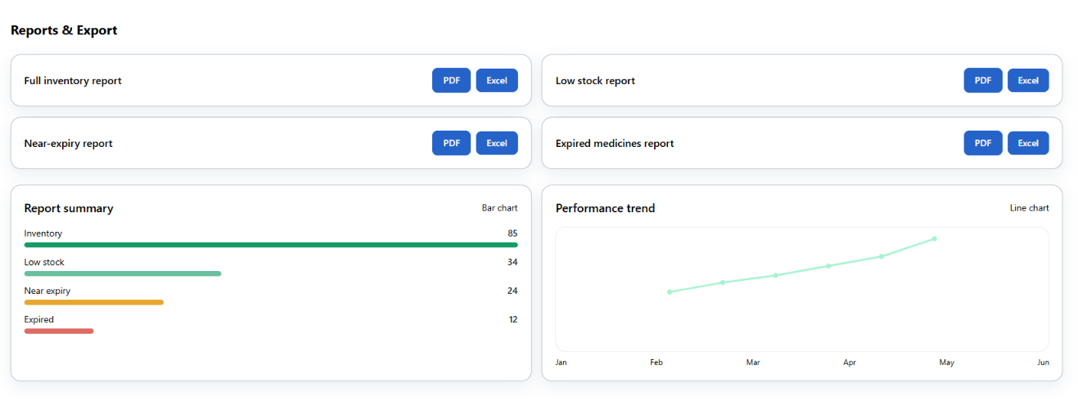
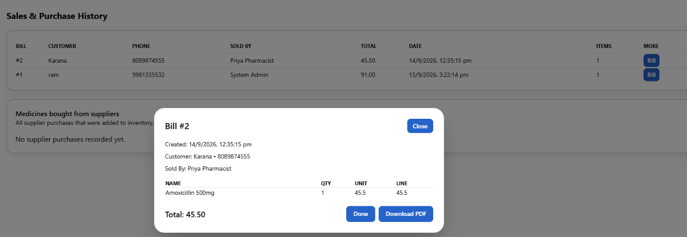
Core Features of MediStock Platform
User Authentication & Role-Based Access
Dashboard & Analytics
Reports
Purchase Management

Slide 5
Challenges Facing Medical Inventory Management
1
2
Manual Inventory Management
Medicine Expiry Risk
Difficult in maintaining accurate medicine stock records.
Risk of medicines getting expired without timely identification.
3
4
Low-Stock Detection
Inventory Visibility
Difficult in identifying medicines that are running low or out of stock
Difficult in getting a centralized view of stock, purchases and inventory activities.
5
6
Supplier & Purchase Management
Role-Based Access
Different users require different levels of access to system functionalities.
Difficult in managing suppliers, purchases and medicine replacement.

Slide 6
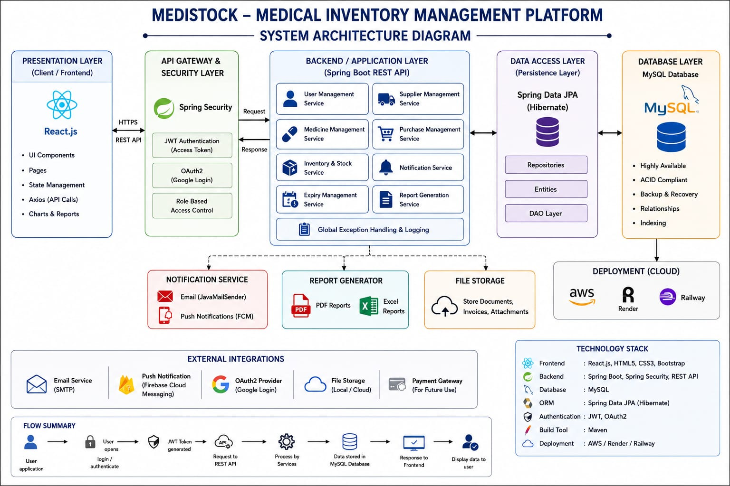
System Architecture Overview

Slide 7
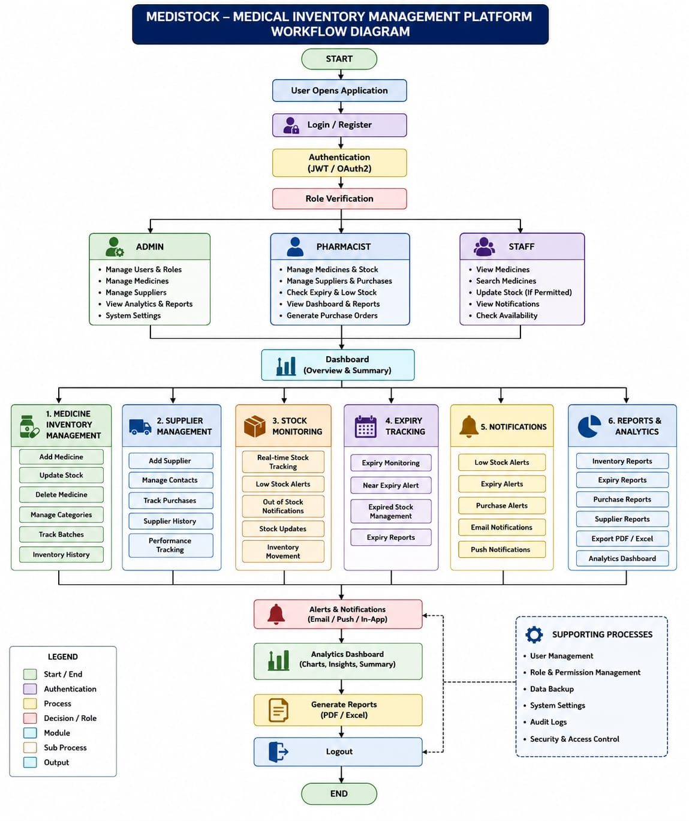
Work Flow

Slide 8
Challenges and Solutions in MediStock
1
2
Manual Inventory Management
Out-of-Stock Situations
Automate inventory records and stock updates. Reduce manual work and data-entry errors. Maintain accurate and up-to-date stock information.
Continuously monitor medicine stock levels. Compare available stock with minimum stock thresholds. Alert staff when medicines are low or out of stock.
3
4
Delayed Notifications
Difficult Decision Making
Staff may not receive timely information about low-stock medicines. Notify staff about near-expiry and expired medicines.
Enable timely action and restocking.
Provide real-time inventory information in one place. Display stock, expiry, and inventory trends clearly. Support faster and data-driven decisions.

Slide 9

Measurable Outcomes and Positive Impact
Improved Inventory Accuracy
Reduced Expiry-Related Wastage
Enhanced Inventory Management
Automated stock updates help maintain accurate inventory records. Reduces manual errors and stock discrepancies.
Automated expiry tracking identifies medicines nearing expiration. Timely alerts help staff take action before medicines expire.
Real-timer monitoring provides better visibility of stock levels. Low-stock and out-of-stock alerts support timely restocking.

Slide 10
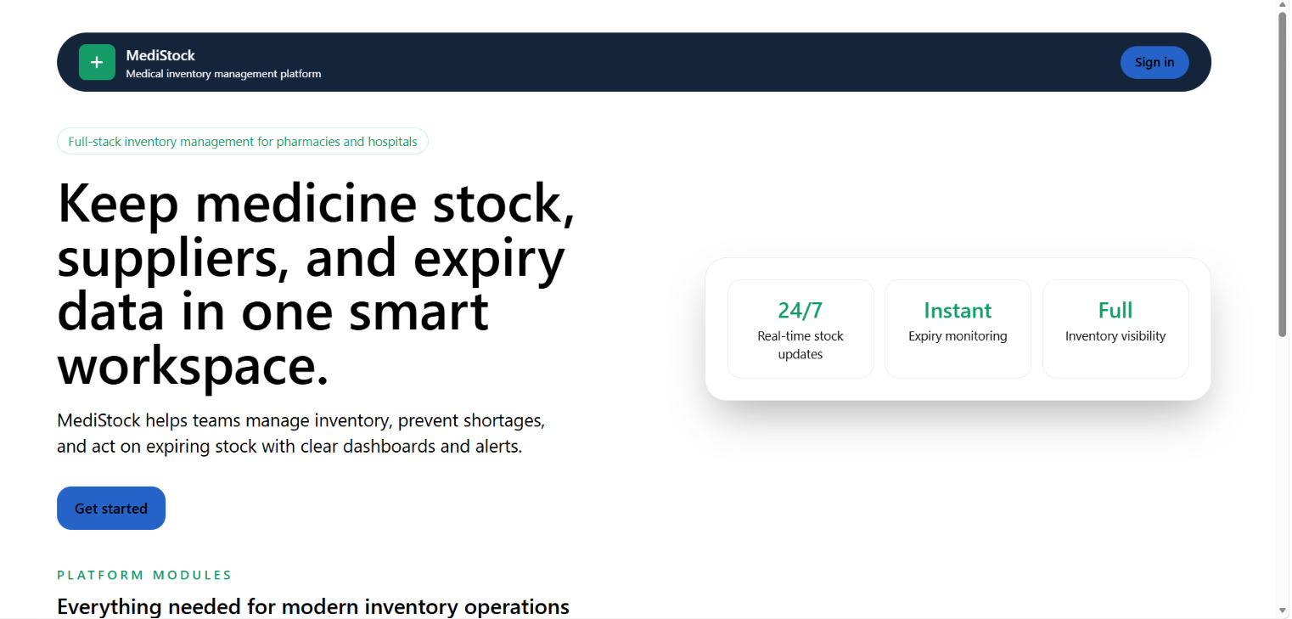
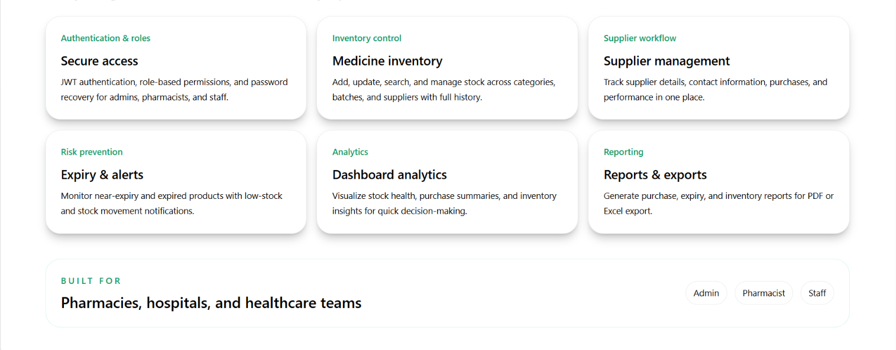
User Interface & System Features

Slide 11
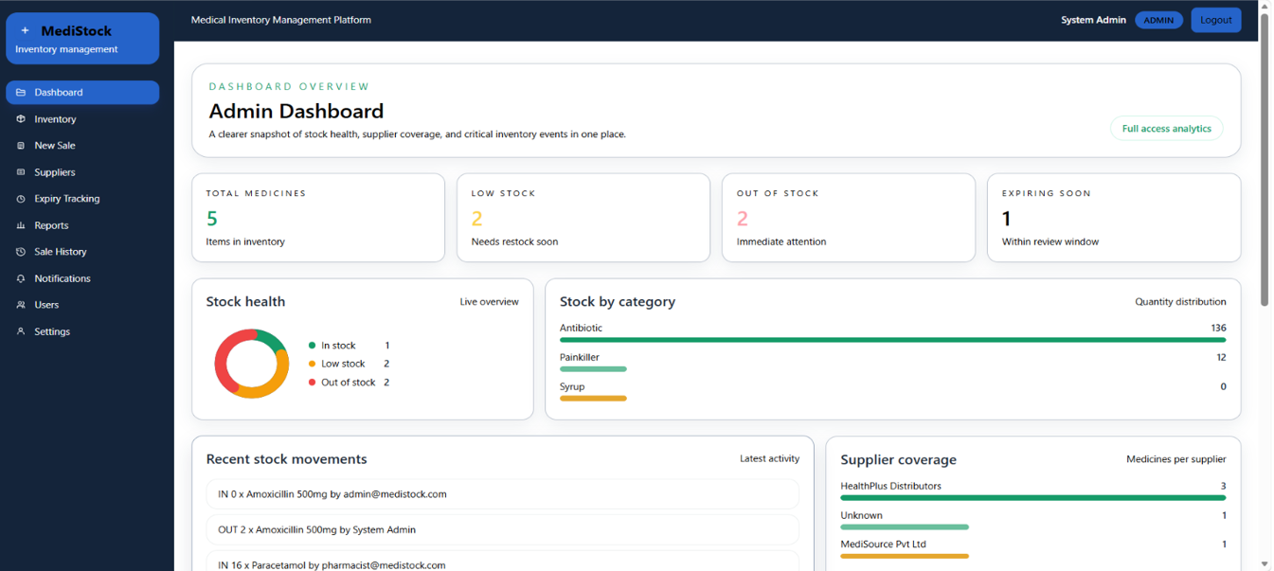
Login Page
Admin Dashboard

Slide 12
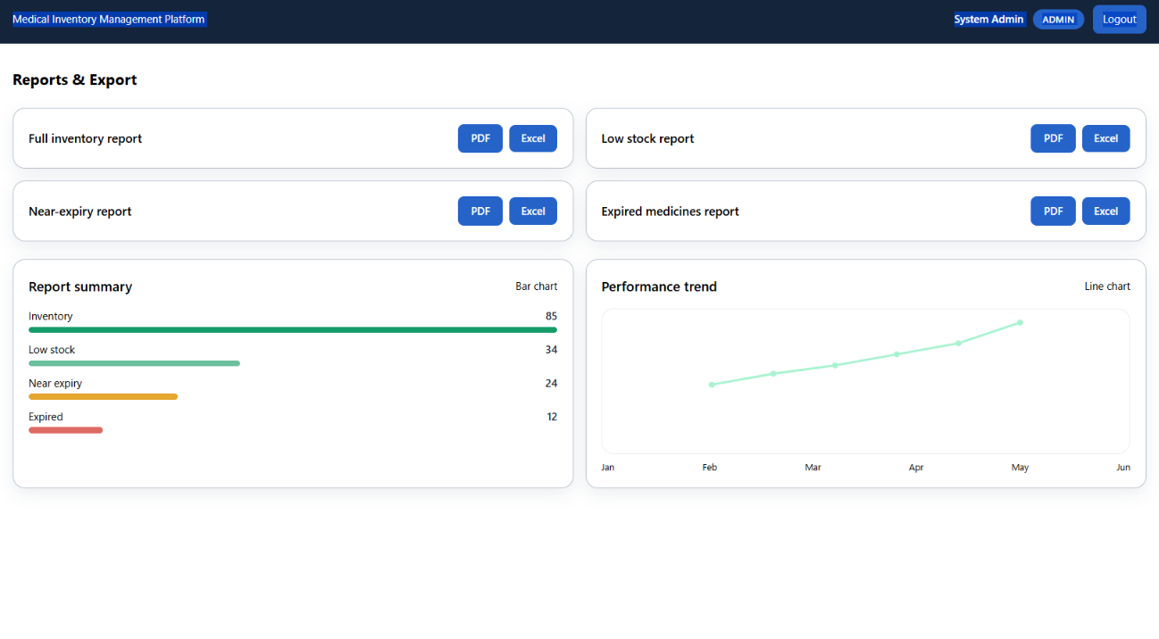
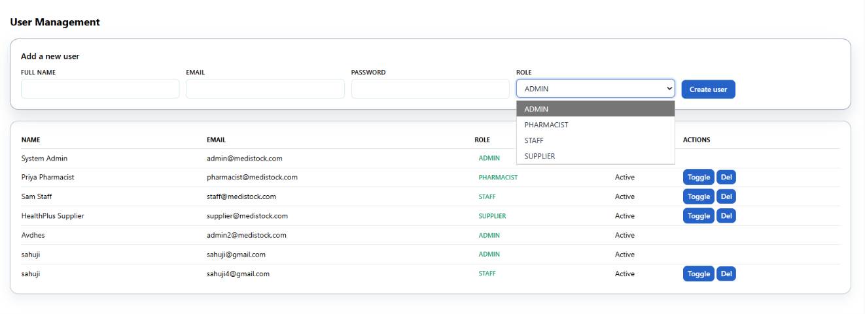

Slide 13
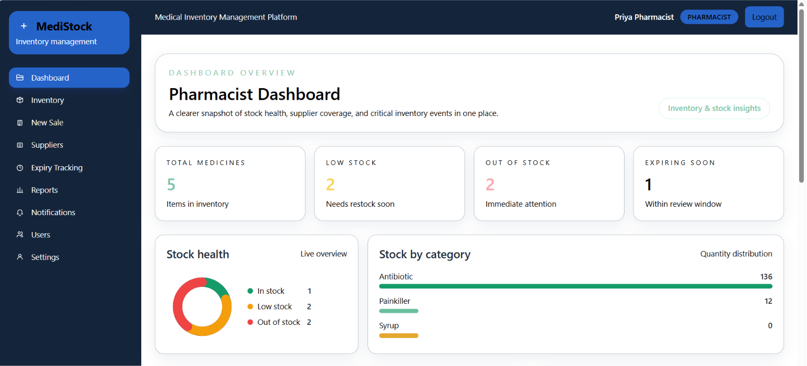
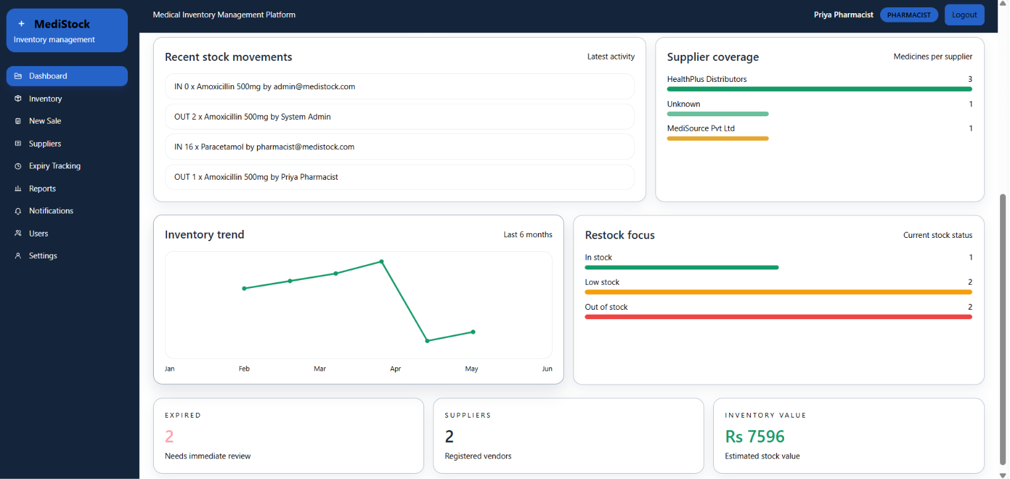

Slide 14
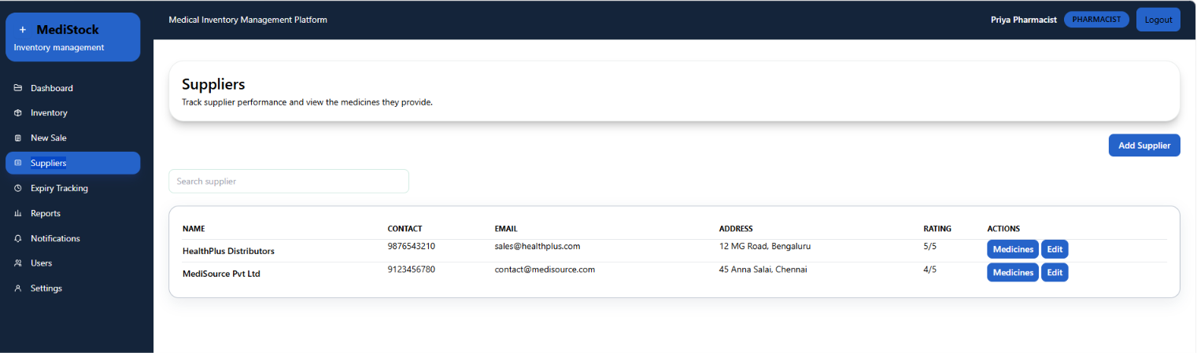
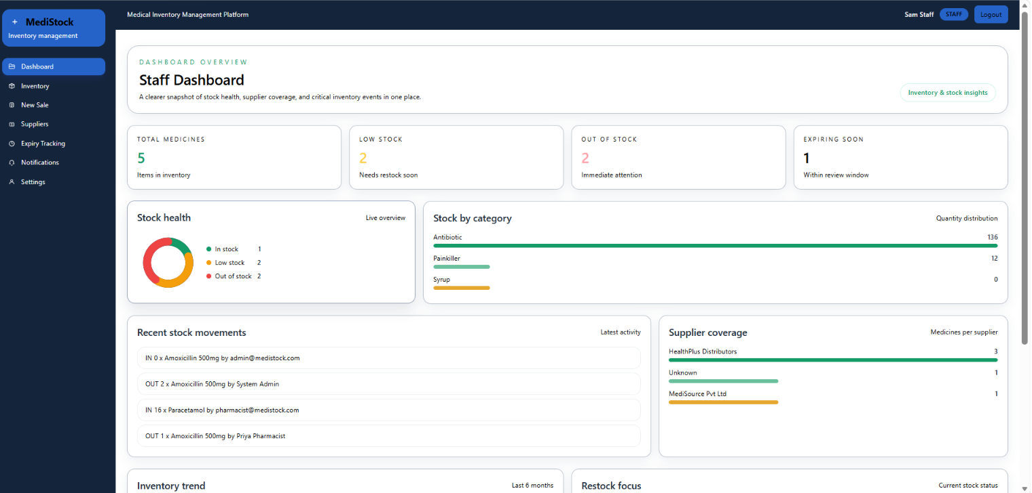

Slide 15
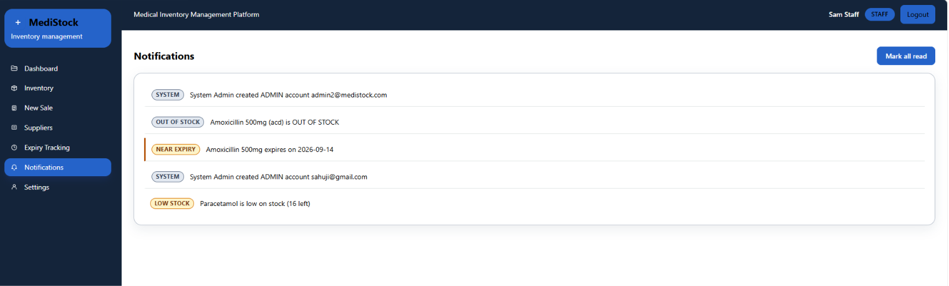

Slide 16
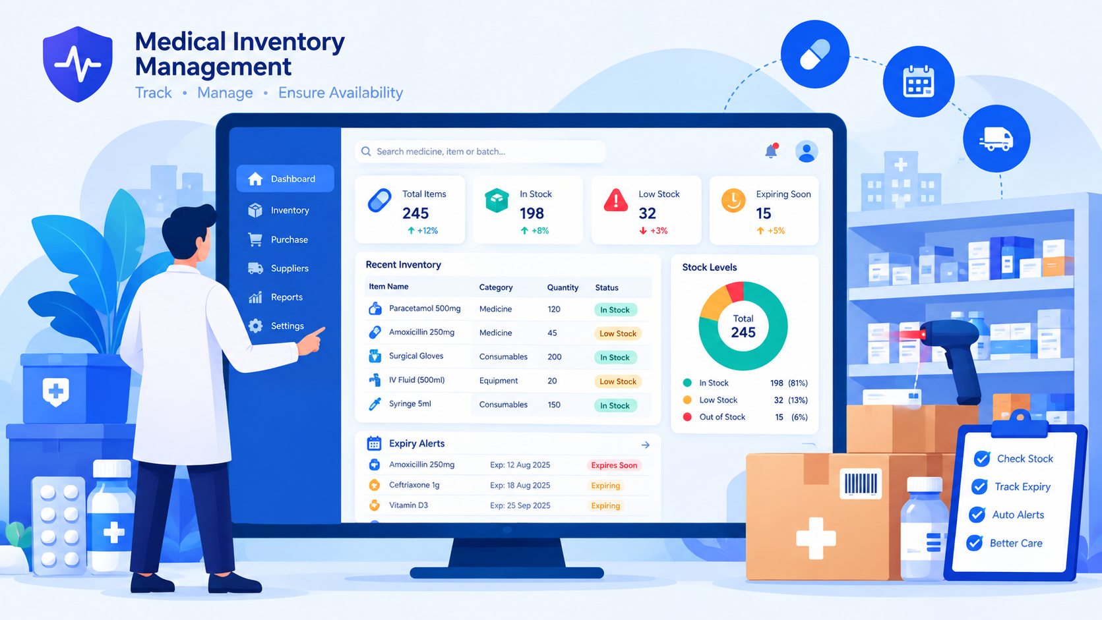
Medical Inventory Management Process
Simple Medicine Onboarding Steps
The registration process is designed to be straightforward and efficient, allowing staff to easily add medicine, stock and expiry details..
Secure Authentication Features
JWT authentication and role-beased access help protect inventory data and prevent unauthorized access.
Comprehensive Dashboard Access
Once logged in, staff can access the Medistock dashboard to monitor stock levels, expiry status, alerts, analytics, and reports.

Slide 17
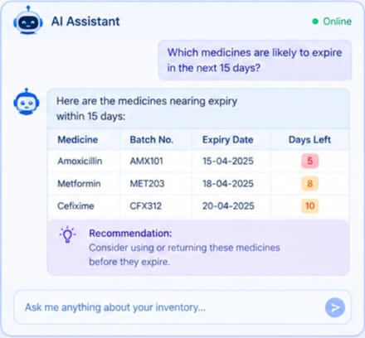
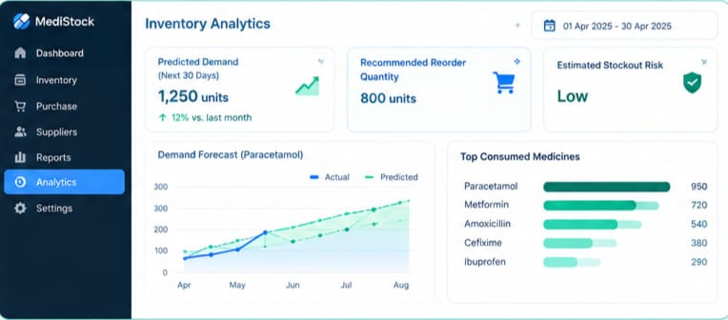
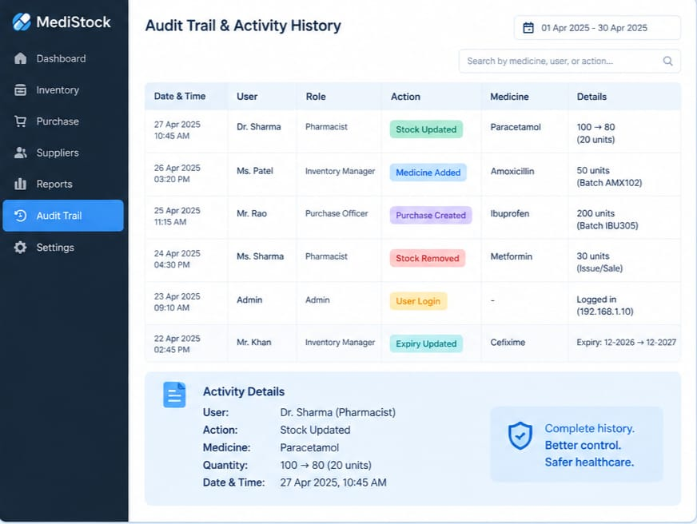
Future Enhancements for MediStock
AI –Assisted Management
Predict Inventory Analytics
Digital Audit Trail & Activity History
  Predict expiry risks and identify inventory trends.
  Recommend suitable stock levels for medicines.
  Support faster and smarter inventory decision.
  Forecast medicine demand and consumption patterns.
  Suggest optimal stock levels and reorder quantities.
  Reduce shortages and excess inventory.
  Record and track important user activities.
  Focus on security , accountability , store date and time.
  Help identify incorrect or unauthorized inventory changes.

Slide 18
TEAM-2 MEMBERS
Avdhesh Sahu
Veekshitha Pudhicheri
Ajay Rajendra Sapkale

Slide 19
Presentation Video...
https://drive.google.com/file/d/1GVKjgovCBcyBQFLASBVszaOE1WSFtE7L/view?usp=sharing

Slide 20
Q n A

Slide 21

Thank You

